Slide 1


SMART INDIA HACKATHON 2025
TITLE PAGE
Problem Statement ID – SIH25061
Problem Statement Title- Digitize and Showcase Monasteries of Sikkim for Tourism and Cultural Preservation
Theme- Tourism
PS Category- Software
Team ID-
Team Name- AlgoBreakers

Slide 2
IDEA TITLE
AlgoBreakers
Proposed Solution (Describe your Idea/Solution/Prototype)
Detailed explanation of the proposed solution : A hybrid solution combining VR/AR experiences, digital archives, multilingual platforms, and AI-powered cultural guidance can preserve monasteries digitally while promoting tourism in a respectful, sustainable way.
How it addresses the problem : Our solution directly addresses the challenges of monastery digitization by combining affordable technology, cultural sensitivity, and community involvement, ensuring monasteries are preserved digitally while making them accessible to the world.
Innovation and uniqueness of the solution : These solutions are unique because they are:
1) Culture-specific (designed around Sikkim’s monasteries, not generic tourism).
2) Respectful & inclusive (balance between tourism and spiritual preservation).
3)Tech + Community hybrid (VR/AI + local participation).
4)Sustainability-focused (reducing physical strain on heritage sites).

Slide 3
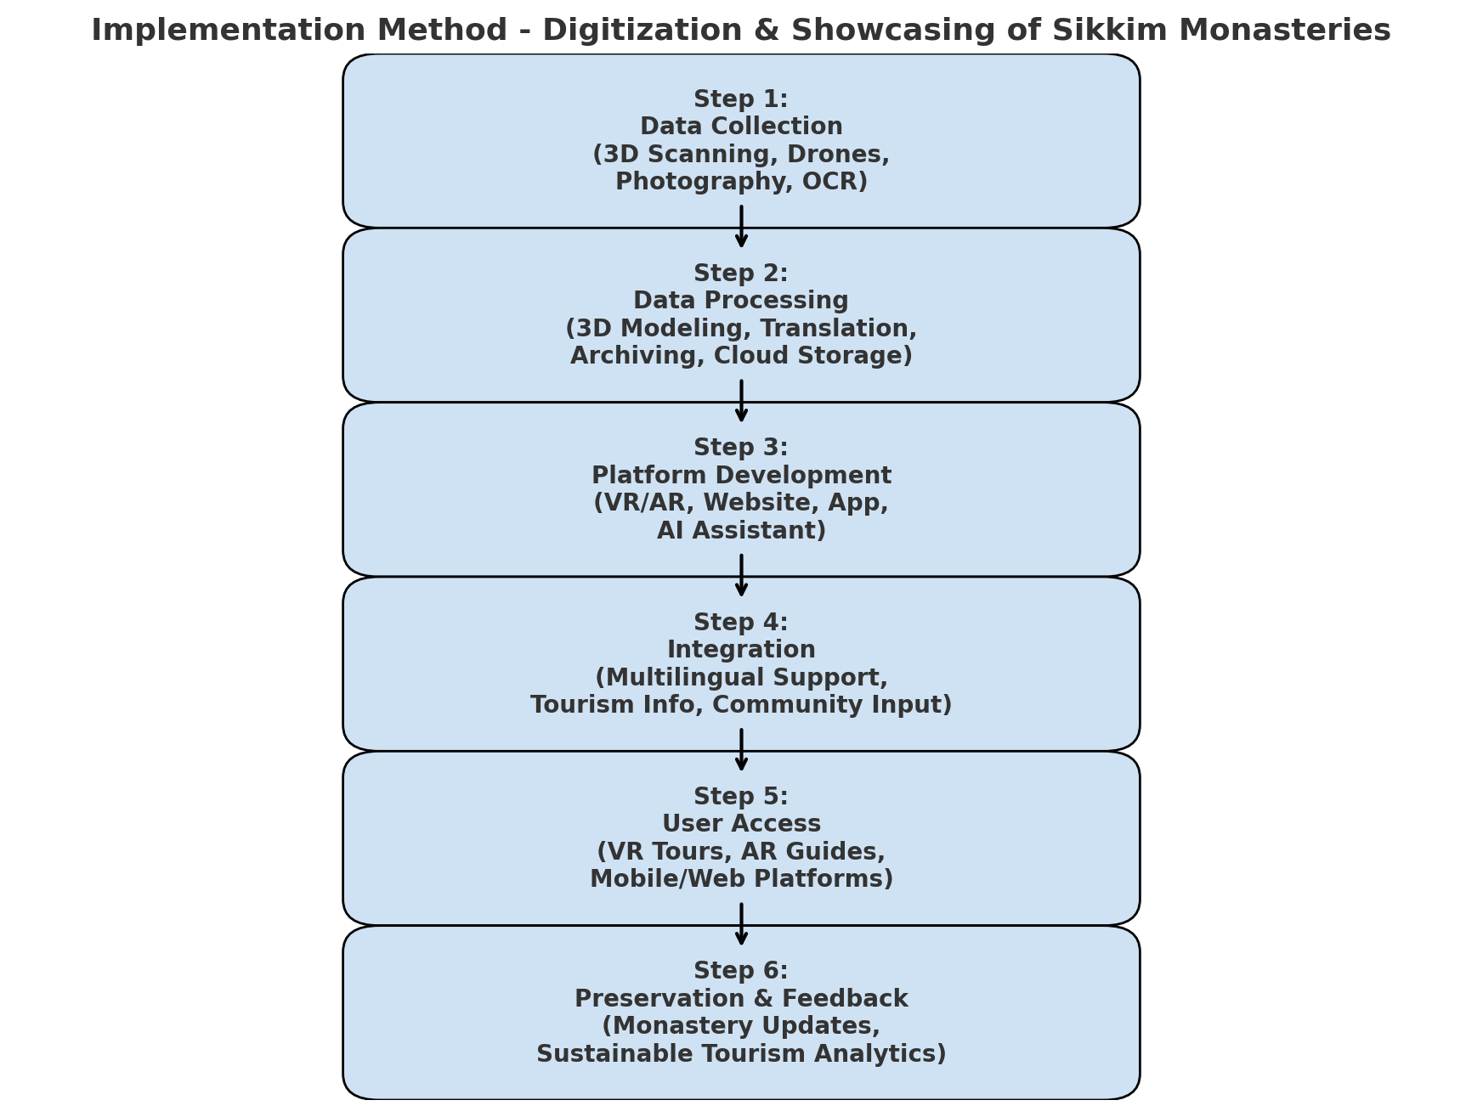
TECHNICAL APPROACH
AlgoBreakers
Technologies to be used (e.g. programming languages, frameworks, hardware) :
1. Frontend (User Experience)
HTML, CSS, JavaScript → for the basic structure, styling, and interactivity.
Responsive design → works on mobile, tablet, and desktop.
3. Features of the Website
Monastery Information Pages → history, timings, rules.
Photo & Video Gallery → simple immersive content.
Interactive Map → monastery locations with Google Maps API.
Search & Filter → by location, type, or history.
Methodology and process for implementation(Flow Charts/Images/ working prototype) :

Slide 4
FEASIBILITY AND VIABILITY
AlgoBreakers
Analysis of the feasibility of the idea: High (technically possible, culturally adaptable, fundable).
Potential challenges and risks: : Infrastructure, cost, cultural sensitivity, and sustainability.
Strategies for overcoming these challenges: Community involvement, affordable tech, phased rollout, partnerships with government + NGOs

Slide 5
IMPACT AND BENEFITS
AlgoBreakers
Potential impact on the target audience:
Cultural Preservation: Safeguards monasteries from over-tourism and physical degradation.
Education: Makes Buddhist knowledge and heritage accessible globally.
Sustainable Tourism: Reduces strain on monasteries, ensures eco-friendly growth.
Economic Growth: Creates new jobs in digitization, tourism tech, and cultural content creation.
Community Empowerment: Locals become custodians and narrators of their own culture.
Benefits of the solution (social, economic, environmental, etc.):
The solution benefits all stakeholders — monasteries (preservation), locals (empowerment), tourists (better experiences), government (tourism revenue), and researchers (knowledge access).

Slide 6
RESEARCH AND REFERENCES
AlgoBreakers
Details / Links of the reference and research work:
Prototype

